Slide 1
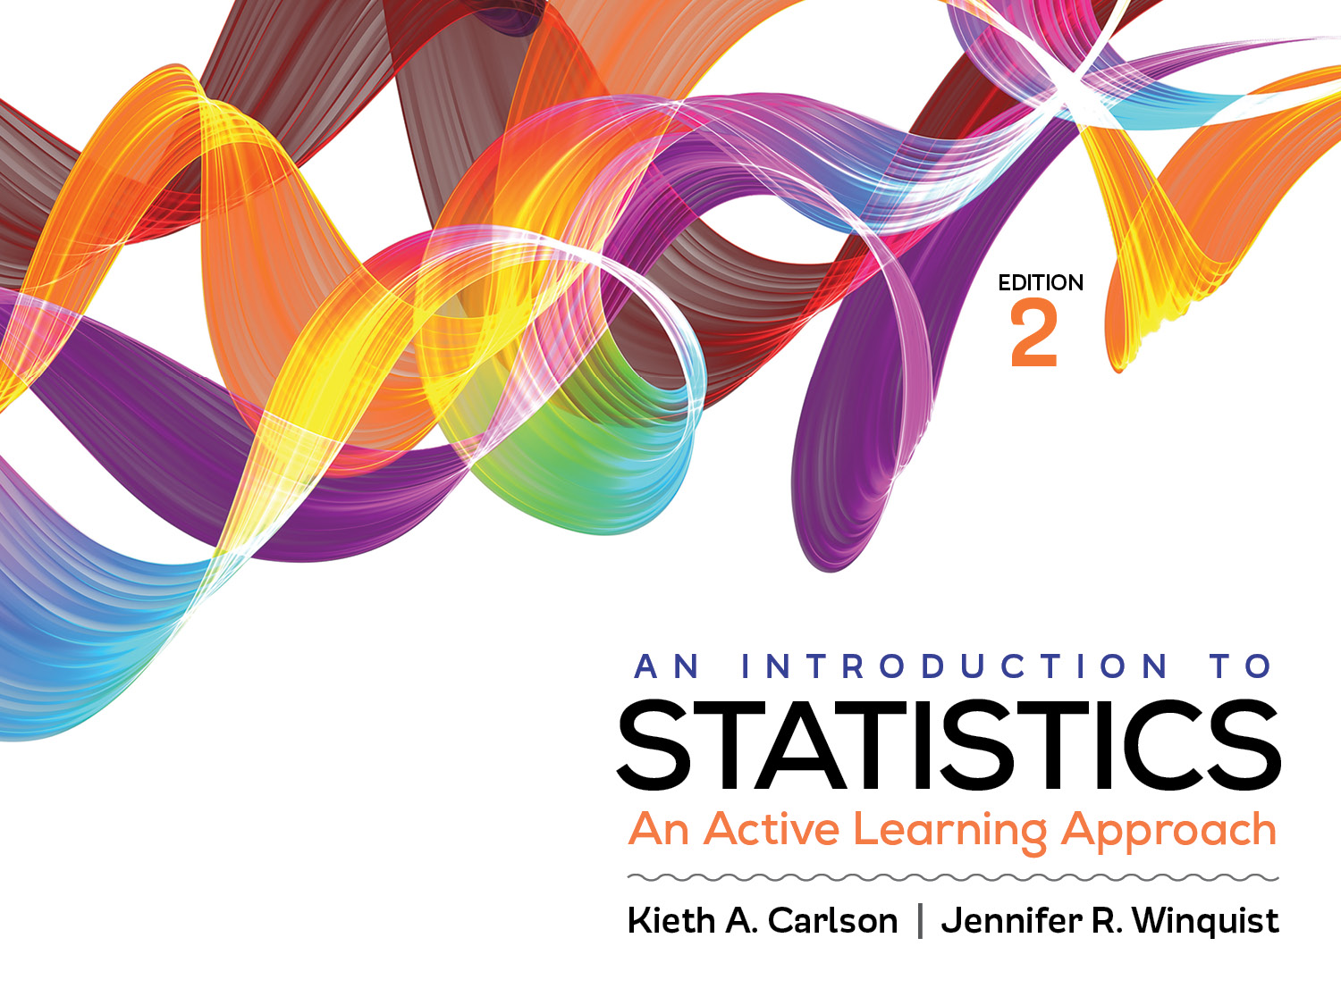
Introduction to Activity 2.1

Slide 2
Activity 2.1 will require you to:
Compute the mean, median, and mode
List of values
Frequency table
Identify the best measure of central tendency for given data
Explain how the mean “defines” center by balancing deviation scores

Slide 3
Computations
In the activity, you will practice finding the mean, median, and mode.
Be sure to practice using the statistics mode on your calculator.
Instructions for many TI calculators are on Blackboard in the Answer Keys folder
If your calculator is not on the list, do a Google search for your calculator

Slide 4
Choosing a measure of central tendency
Answer the following questions:
If data are Nominal, use the ________________.
If data are Ordinal, use the ________________.
If data are Interval/Ratio, use the ____________.
unless distribution is ________ or
it contains _______, then use the __________.

Slide 5
Choosing a measure of central tendency
If data are Nominal, use the . . . Mode
If data are Ordinal, use the . . . Median
If data are Interval/Ratio, use the . . . Mean
unless distribution is skewed or
it contains outliers, then use the . . . Median

Slide 6
How does each measure of central tendency define “center”?
Mode ➔ most common score
Median ➔ middle score (50% of scores above and below it)
Mean ➔ balances deviations scores

Slide 7
Deviation Scores
Every score has a distance from the mean called a deviation score
Score – Mean
Sample: (X–M)
Population: (X–µ)
The mean balances deviation scores, for example:

Slide 8
Compute the mean

Slide 9
Compute the mean
M = ∑X / N
M = [2(1) + 3(4) + 4(3) + 5(1) + 6(1) + 7(1)]/ 11
M = 44 / 11 = 4
Mean

Slide 10
Score | X–M
2 | 2–4 = −2
3 | 3–4= −1
3 | 3–4= −1
3 | 3–4= −1
3 | 3–4= −1
Σ(X–M) = −6
Score | X– M
4
4
4
Σ(X–M) =
Score | X– M
5
6
7
Σ(X–M) =
Mean

Slide 11
Score | X–M
2 | 2–4 = −2
3 | 3–4= −1
3 | 3–4= −1
3 | 3–4= −1
3 | 3–4= −1
Σ(X–M) = −6
Score | X– M
4 | 4–4=0
4 | 4–4=0
4 | 4–4=0
Σ(X–M) = 0
Score | X– M
5 | 5–4= 1
6 | 6–4= 2
7 | 7–4= 3
Σ(X–M) = 6
Mean

Slide 12
Score | X–M
2 | 2–4 = −2
3 | 3–4= −1
3 | 3–4= −1
3 | 3–4= −1
3 | 3–4= −1
Σ(X–M) = −6
Score | X– M
4 | 4–4=0
4 | 4–4=0
4 | 4–4=0
Σ(X–M) = 0
Score | X- M
5 | 5–4= 1
6 | 6–4= 2
7 | 7–4= 3
Σ(X–M) = 6
Mean

Slide 13
Helpful Hints
Do not just answer the questions in the activity. Be sure to read the information in the activities and understand why the answers are correct.
As always, there is new information in the activity that was not included in the readings.
Work together
Figure out how to use the stats mode on your calculator; later in the course your effort will be highly rewarded.

